Slide 1

Object Detector for Road Signs
By Ka Hung Lee

Slide 2

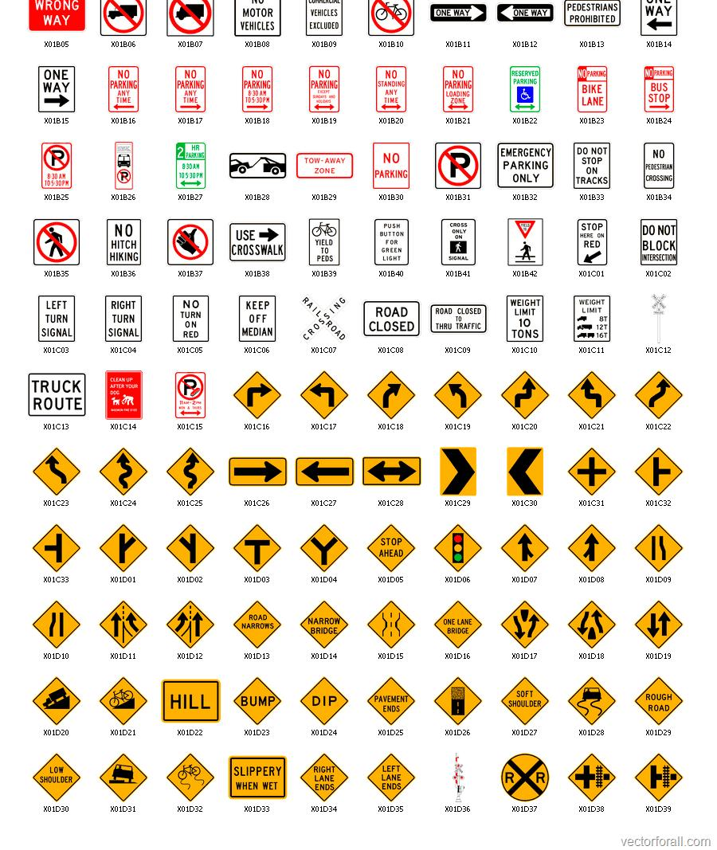
Motivation
Roads and motorways are essential infrastructure that physically connects places together
They provide ease of assess for vehicles to travel
Road signs or traffic signs are constructed to guide or provide instructions for road users

Slide 3
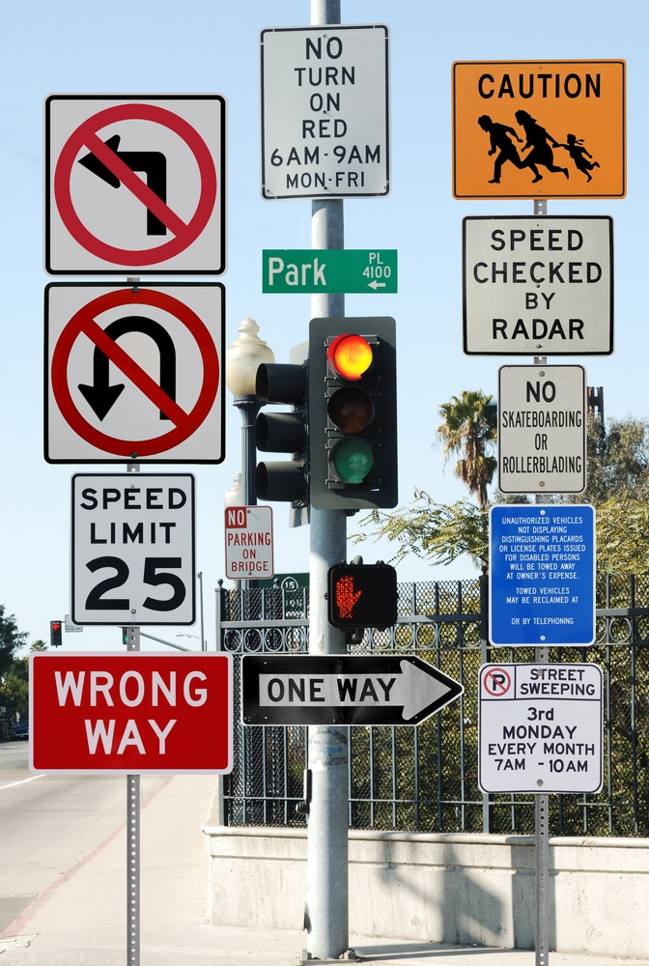
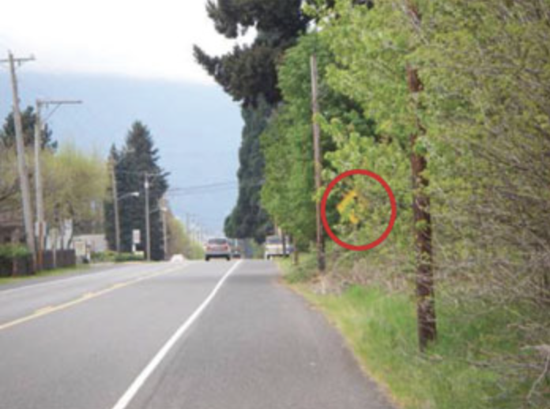
Where is that sign?
However, there could be times when driver wish to:
Locate/Identify specific road signs at ease
Be made aware of upcoming road signs
To solve this problem, we could create a program that could detect specific road signs

Slide 4

Project Plan
Collect Data
1
Analyze Data
2
Preprocess Data
3
Model Data
4
Evaluate Model
5
Test Model
6

Slide 5
Project Plan
Collect Data
1
Analyze Data
2
Preprocess Data
3
Model Data
4
Evaluate Model
5
Test Model
6

Slide 6

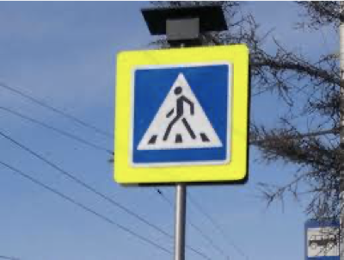
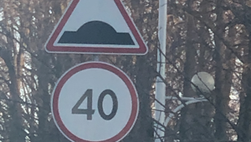
Original Dataset
Source: https://www.kaggle.com/andrewmvd/road-sign-detection
877 images with 4 classes (trafficlight, stop, speedlimit, crosswalk)

Slide 7
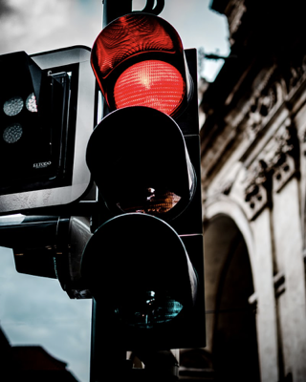
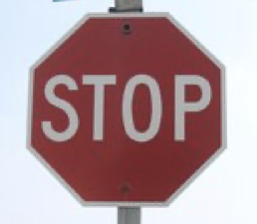
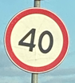
Number of Labels
Original dataset
Label Name
trafficlight | stop | speedlimit | crosswalk
Total
170 labels | 91 labels | 783 labels | 200 labels

Slide 8
Project Plan
Collect Data
1
Analyze Data
2
Preprocess Data
3
Model Data
4
Evaluate Model
5
Test Model
6

Slide 9
Preprocessing Data
Although the dataset already came with “ground-truths”, they need to be verified
All labels/annotations were checked using LabelImg

Slide 10
LabelImg
Labeling Tool used: https://github.com/tzutalin/labelImg
Can be used to add/modify existing labels/annotations
Existing labels were modified with 2 additional classes using LabelImg (nostop, yield)

Slide 11
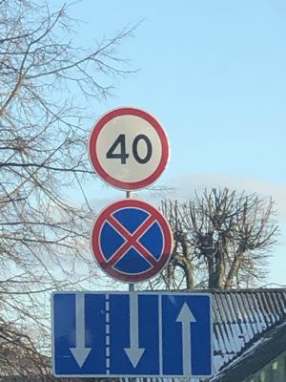
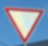
Number of Labels
Dataset after adding new labels (nostop and yield) and modifying old labels
Label Name
trafficlight | stop | speedlimit | crosswalk | nostop | yield
Total
155 labels | 93 labels | 788 labels | 218 labels | 107 labels | 15 labels
-15
+2
+5
+18
+107 (new)
+15 (new)

Slide 12
Additional Data and Augmentation
100 images were added through image augmentation to increase the sample size of yield
Rotation
image blur
noise
yield
nostop

Slide 13
Number of Labels
Dataset w/augmented images
Label Name
trafficlight | stop | speedlimit | crosswalk | nostop | yield
Total
176 labels | 93 labels | 862 labels | 298 labels | 107 labels | 111 labels
+21
+0
+74
+80
+0
+96

Slide 14
Number of Labels
The dataset was partitioned at random roughly 9:1 (training/validation split)
tfrecord files were created for model training and evaluation
Label Name
trafficlight | stop | speedlimit | crosswalk | nostop | yield
Training Size
162 labels | 77 labels | 780 labels | 263 labels | 97 labels | 94 labels
Validation Size
14 labels | 16 labels | 82 labels | 35 labels | 10 labels | 17 labels

Slide 15
Project Plan
Collect Data
1
Analyze Data
2
Preprocess Data
3
Model Data
4
Evaluate Model
5
Test Model
6

Slide 16
What this entails?
Classification: Traffic Light
Object Classification

Slide 17
What this entails?
Object Classification
Object Localization

Slide 18
Classification: Traffic Light
Classification
+
Localization
=
Detection!

Slide 19
Common Approaches
Region-based Convolutional Neural Networks (R-CNNs)
Pros:
Accurate
Cons:
External search algorithm is a performance bottleneck
Slow training time
Memory intensive
Slow detection time
warped region
CNN
Traffic Light? Yes
Stop sign? No
Speed sign? No
3. Compute CNN Features
4. Classify Regions
1. Input
Image
2. Extract Regions

Slide 20
Common Approaches
“Faster” R-CNNs
Pros:
Reduced training time
Faster detection
Still accurate
Cons:
Run time depends on number of proposed region
Feature map of image
Region Proposal Network
CNN
CNN
Proposals
1. Input
Image
2. Compute CNN Features
RoI Pooling Layer
CNN
Object Classifier
3. Create Proposed Regions
4. Classify Regions

Slide 21
Common Approaches
Single-Shot Detector (SSD)
Pros:
Direct detection
Very fast detection
Designed for real-time
Reduced training time
Cons:
Accuracy drops for smaller objects
Feature map of image
Detection Generator
CNN
CNN
3. Locate & Classify Object
1. Input
Image
2. Compute CNN Features

Slide 22
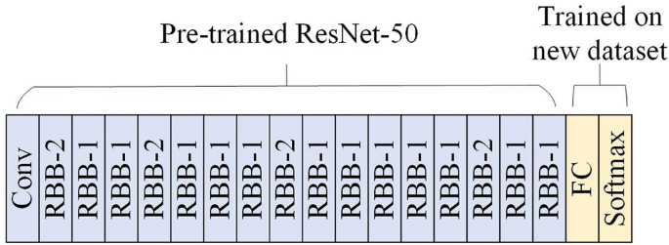
Our Model: SSD Approach
Our model utilizes the saved weights of a pre-trained Retinanet Object Detection model (SSD with Resnet 50 v1) to train our customized model
Utilizes technique known as transfer learning
The model was trained for 25000 steps (2000 warm-up steps)
Total training took roughly half a day with GPU from Google Colab Pro

Slide 23
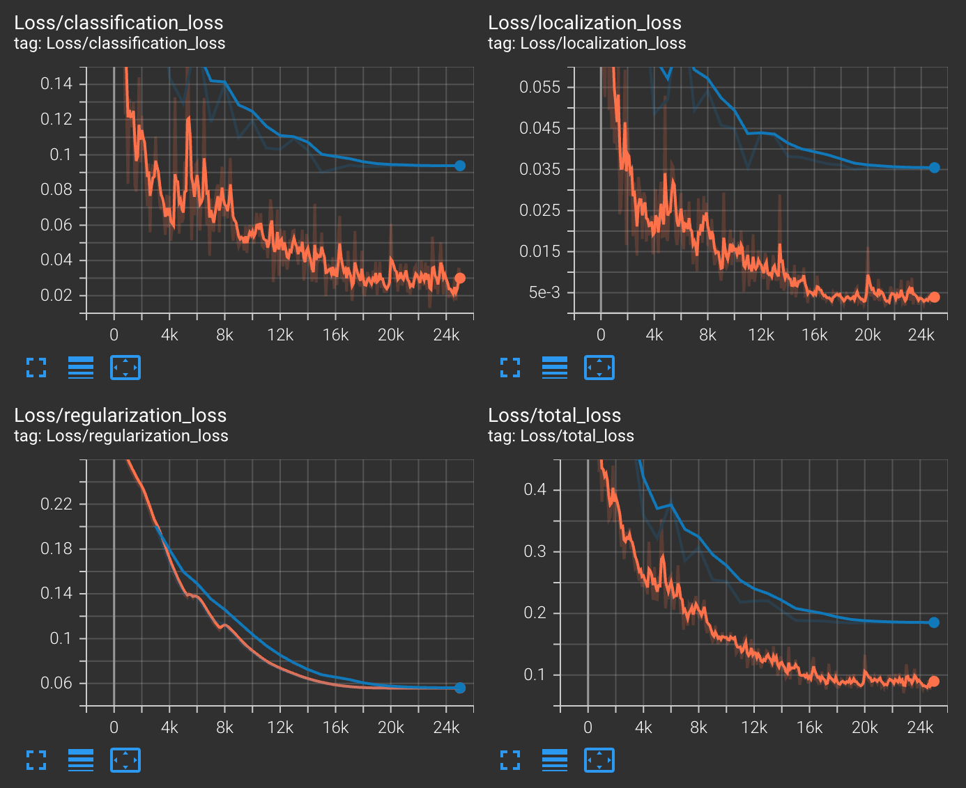
Model Evaluation
Training scores: orange
Validation scores: blue

Slide 24
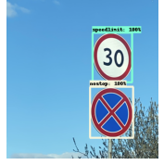
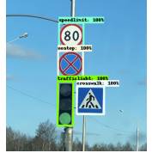
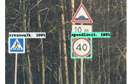
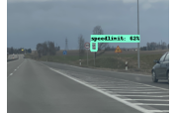
Validation Set

Slide 25
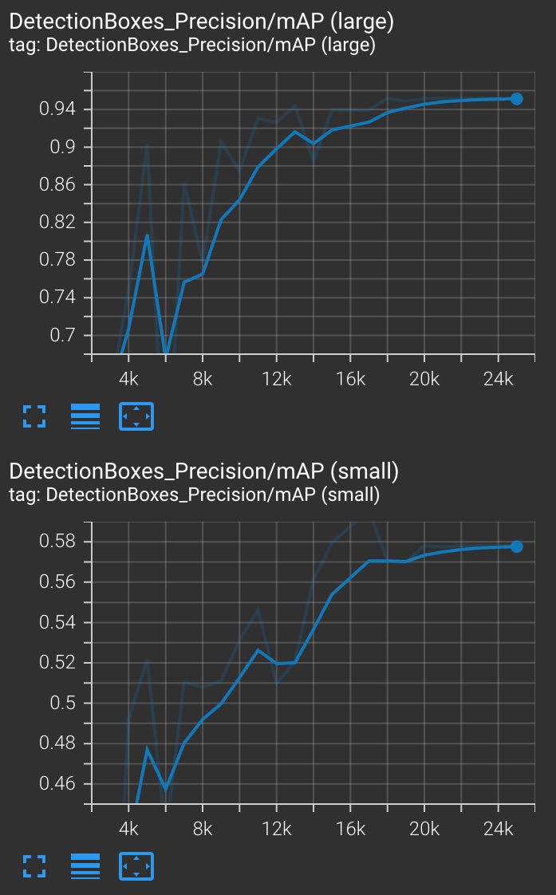
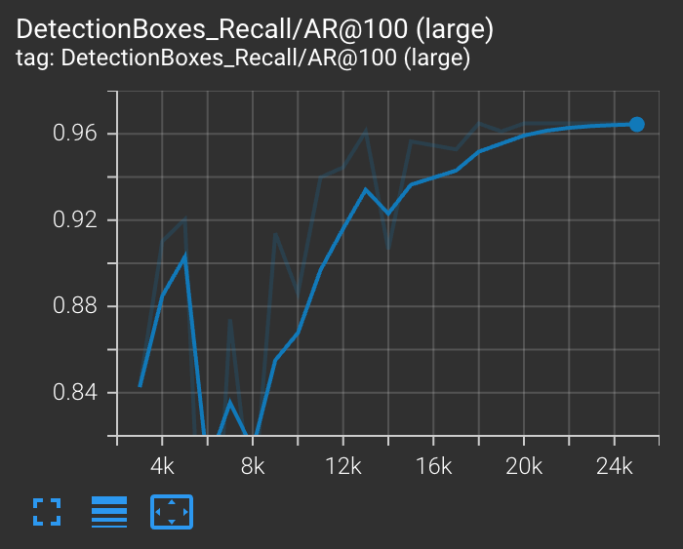
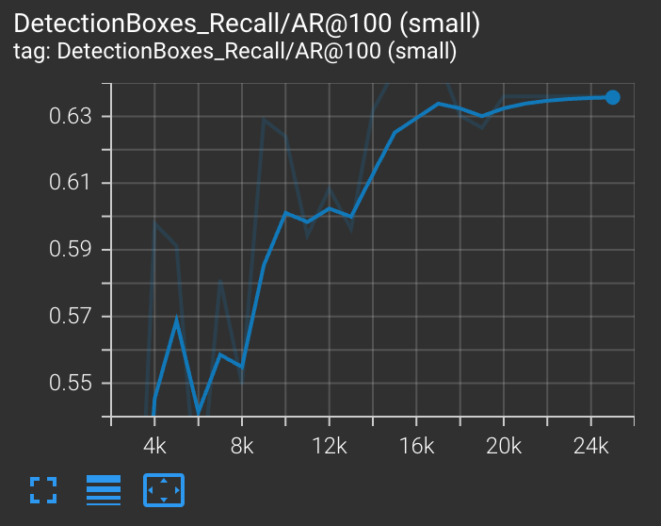
Model Performance (Validation Set)
Precision
Recall
0.94 - 0.95
0.96
For static images, the model perform well for large objects, and less so for small objects
0.58
0.63 - 0.64

Slide 26
Project Plan
Collect Data
1
Analyze Data
2
Preprocess Data
3
Model Data
4
Evaluate Model
5
Test Model
6

Slide 27
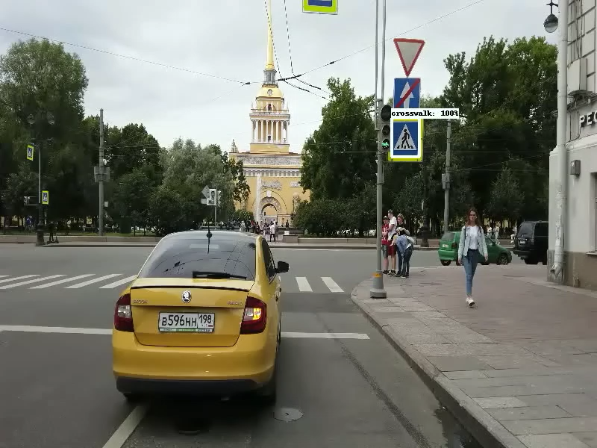
Video Test and Conclusions
The model was able to detect objects on video
Apparent issues:
Detection for yield is spotty
Cars are mistaken for trafficlights
Certain road signs can only be detected close up

Slide 28
Potential Improvements
Include more size variation for labels
Include more images of labels in traffic settings
Increased sample size

Slide 29
Thank you
Questions?
Capstone link: https://github.com/leekahung/object_detector_roadsigns
Profile
LinkedIn: https://www.linkedin.com/in/ka-hung-lee-090634a7/
GitHub: https://github.com/leekahung
Google Scholar: https://scholar.google.com/citations?user=VfIHNYIAAAAJ&hl=en

